Slide 1
Introduction
B.E
B.E. Computer Science from University of Pune
June 2008
CERN
Research Fellow at European Group of Nuclear
Research (CERN) on Grid Computing for one year (Nov 2008 to Nov 2009)
CPA
Founder, CoreCode Programming Academy (previously known as Core Programming Academy) 2009-2025
CPA
I have conducted 14 corporate trainings, including companies such as GS Labs, Volkswagen and Coditas on various subjects like Python, Advanced C/C++, and Golang.
CPA
I have conducted more than 185 batches as part of in-house training in the last 14 years.

Slide 2
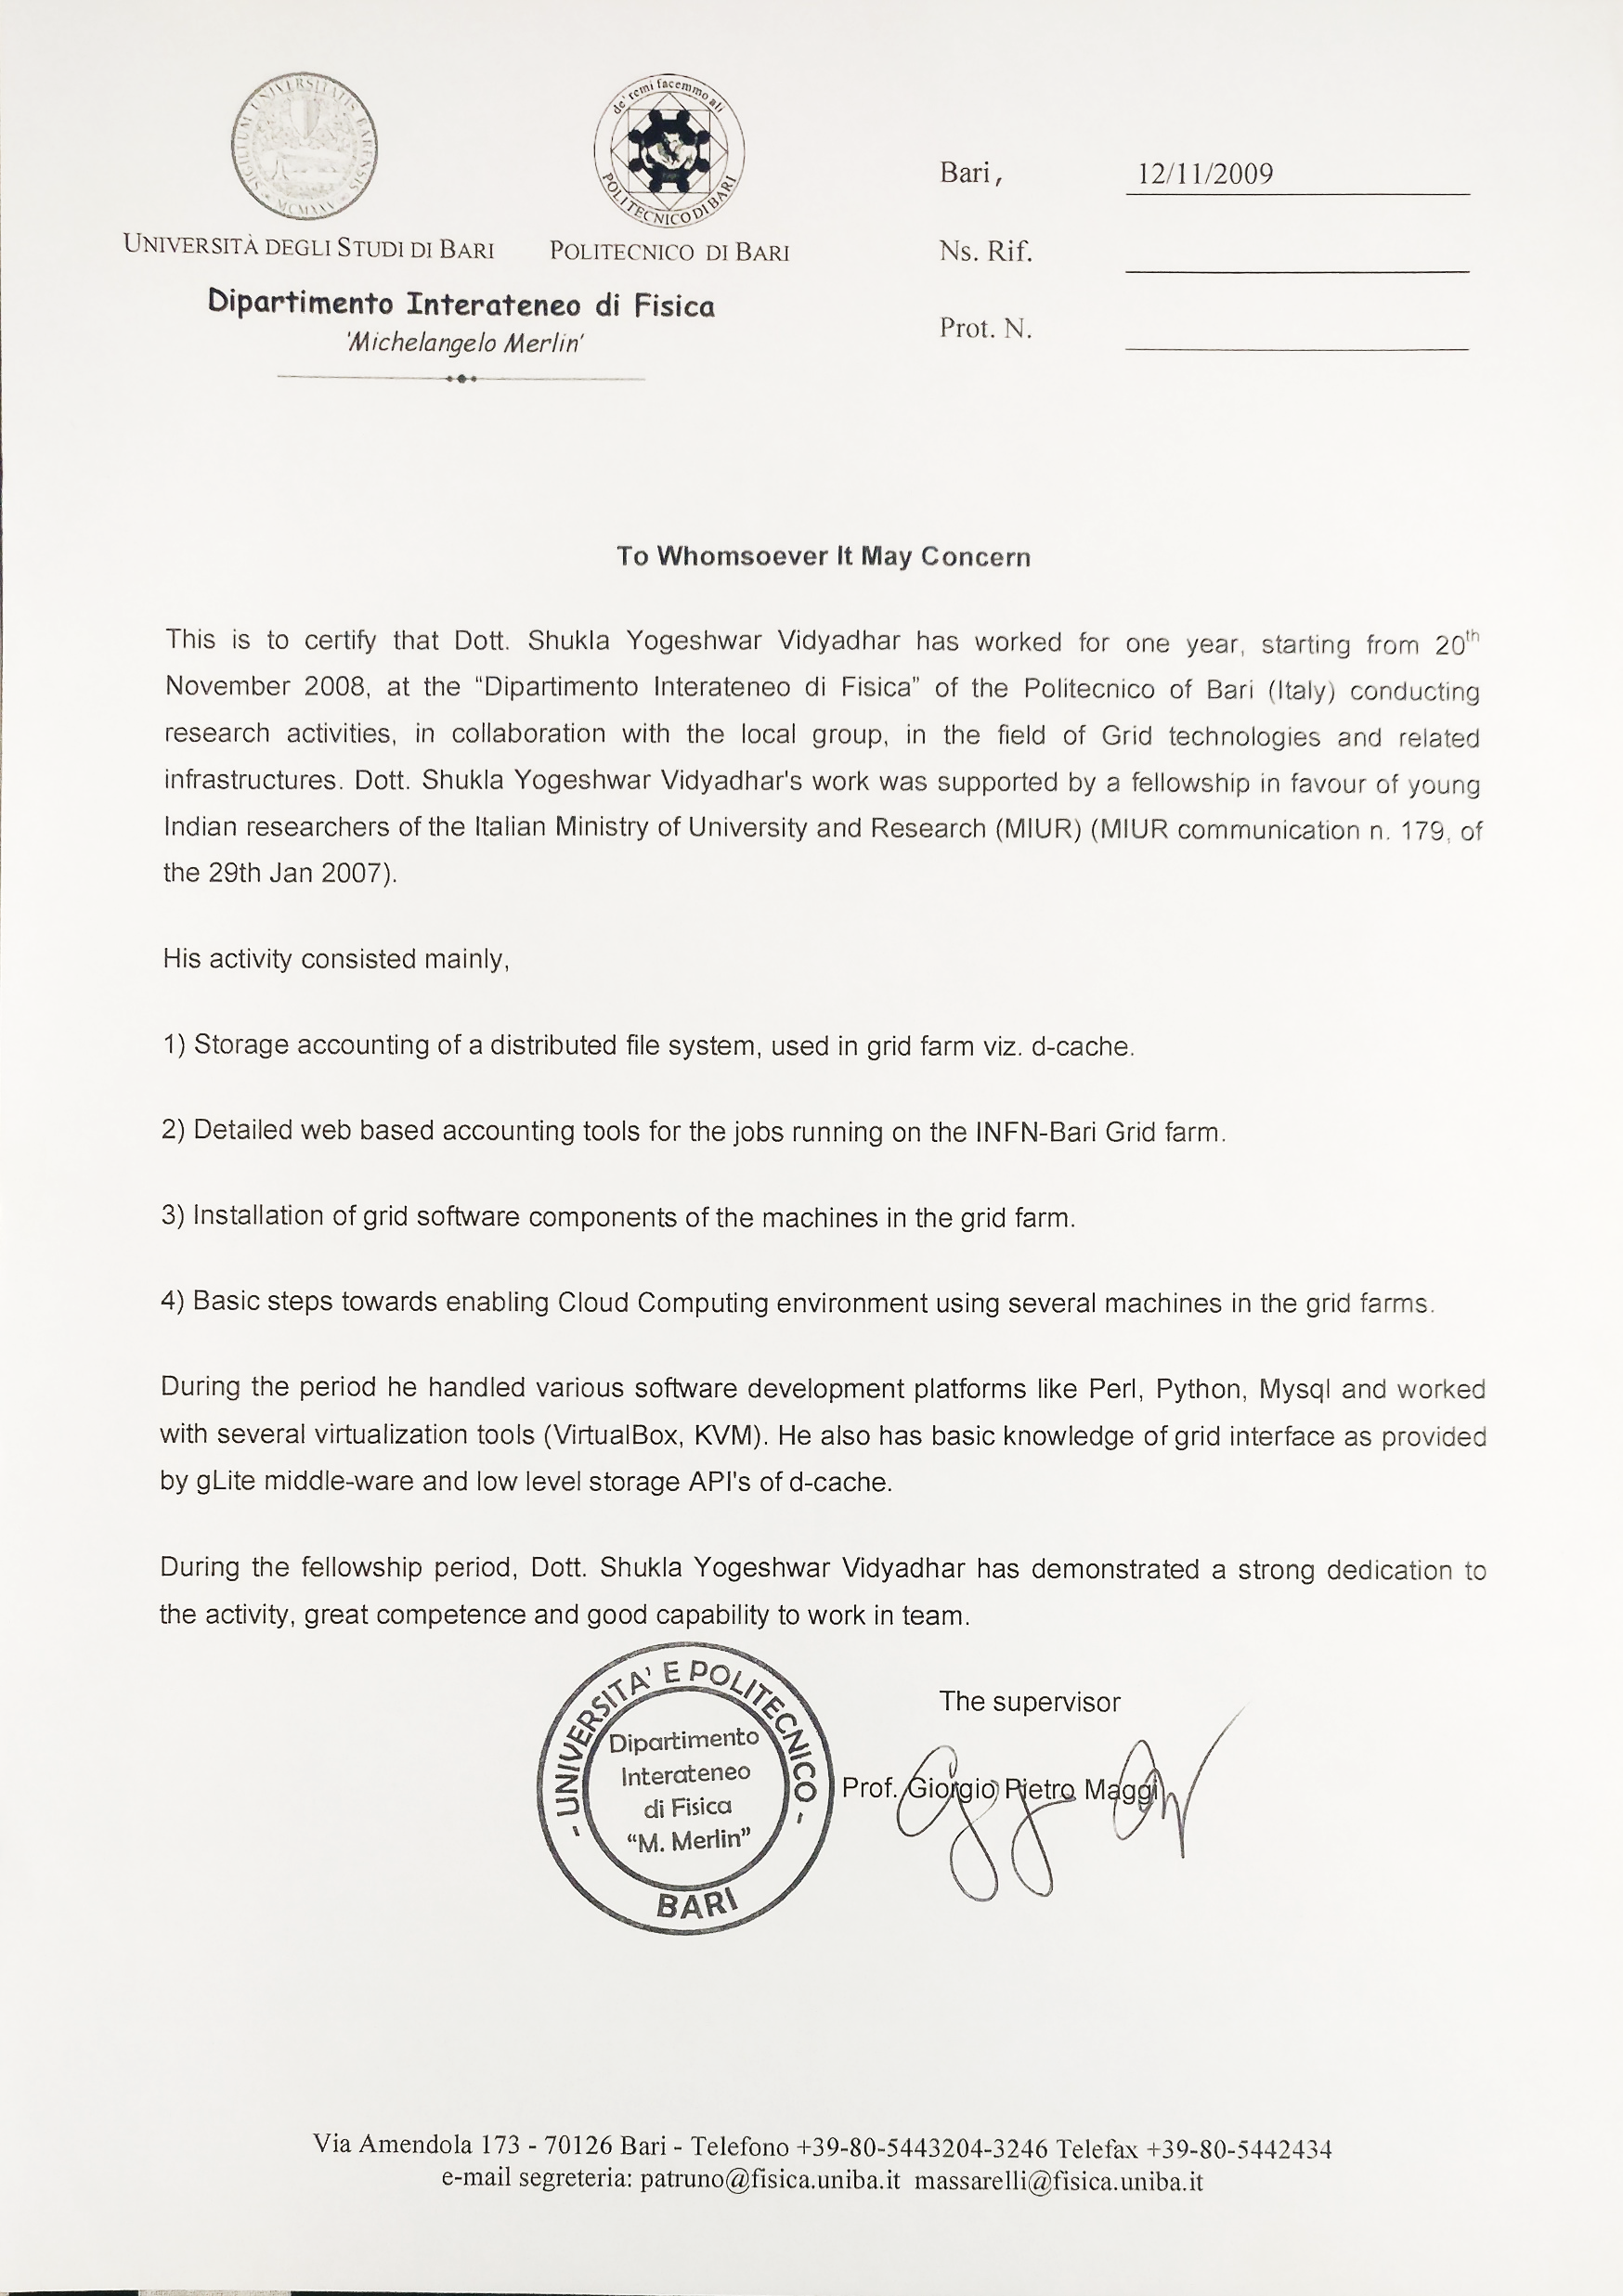
Fellowship Certificate

Slide 3
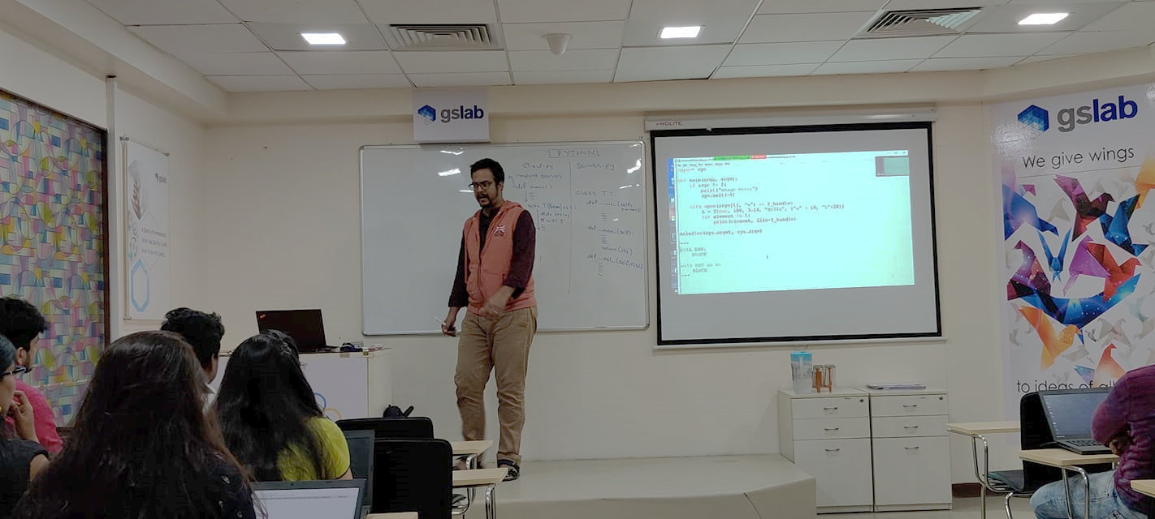
Corporate Training

Slide 4
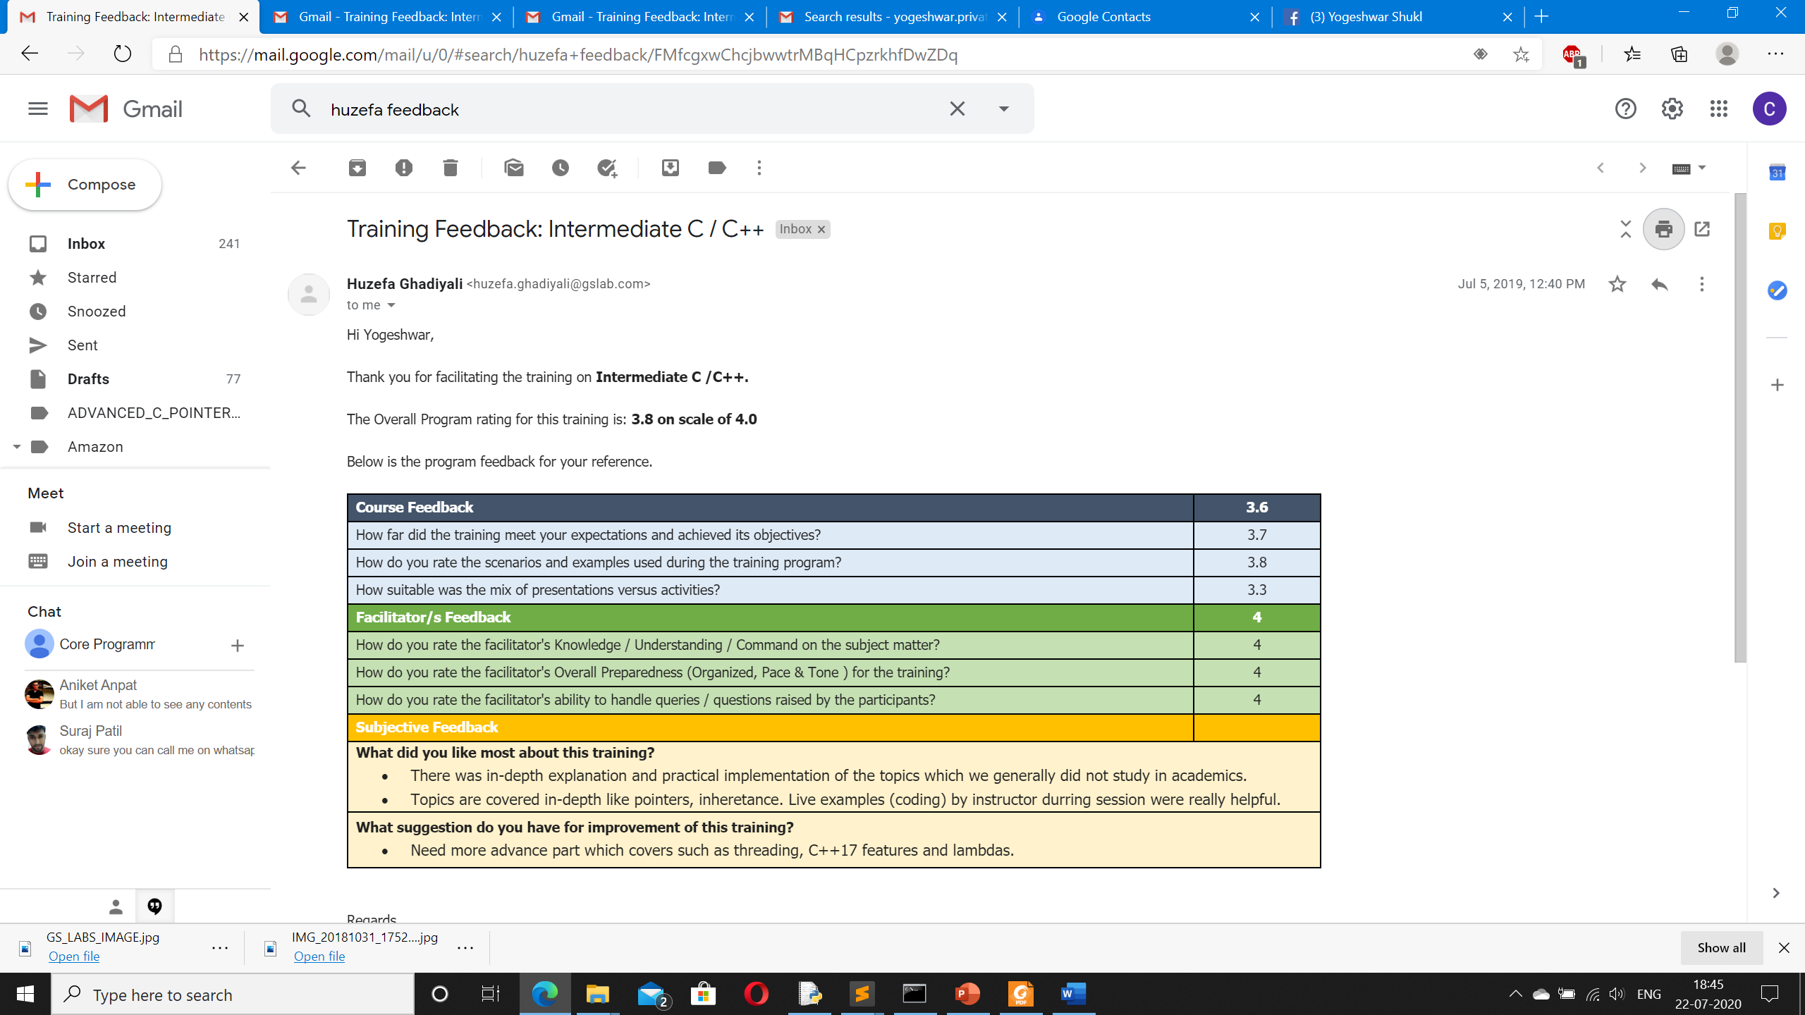
Feedback

